Slide 1
Report on Web Based project Project title: Pure World
Submitted by:
Submitted to:
Shreya khisa
ID:13701066
6th Semester
Session:2012-2013
Dept:Computer Science and Engineering
Nasrin Sultana
&
Shima Chakraborty
Designation: Lecturer
Computer science and engineering
University of Chittagong.

Slide 2
Topics
What’s the idea?
Project objective
Problems in manual system
Preliminary solution
Use cases & actors
Use case diagram
Model
Website visualization
Conclusion

Slide 3
What’s the idea?
“Pure World” is an web based blog where user can post and share their experience about different types of pollution,pollutants,effects and its solution.
What is the polllution?
Pollution is the introduction of contaminants into the natural environment that cause adverse change.
Pollutants,the components of pollution,can be either foreign substances,energies, or naturally occuring contaminants.

Slide 4
Project objective:
Main goal of this project to raise awareness among people about
different types of pollutions,
it’s causes,
effects and
sollutions.

Slide 5
Problem in manual system
It does not contain different types of information about pollutions.
It does not contain latest news about pollutions.
Reader cannot share his/her knowledge or experience about the pollutions.
It does not allow the reader to make comments or ask questions to the author.
Buying a book or paper is costly sometimes.

Slide 6
Preliminary solution:
User friendly.
Provides diiferent types of information about pollutions in one website.
Contains the very latest news about pollutions.
User can share their knowledge and experience by giving post.
User can make comments or make questions to another user post.
Less costly than buying books,because it only needs internet.

Slide 7
Use cases
Register user
Login User
Post article
Comments on article
Edit post
Delete self post
Search for post
Delete post
Delete user
Delete comments
Log out

Slide 8
Actors
User
Administrator

Slide 9
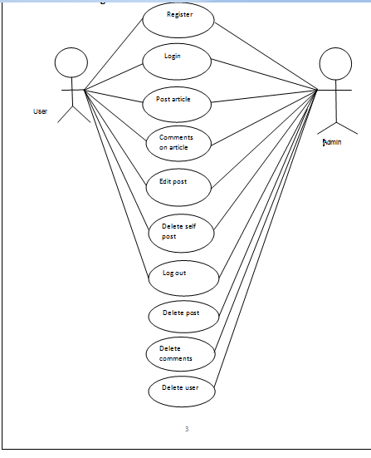
Use case diagram

Slide 10
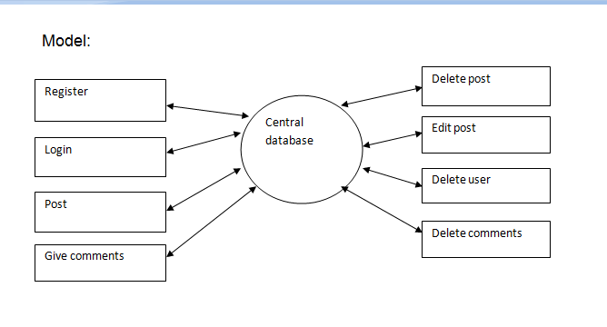
Model

Slide 11
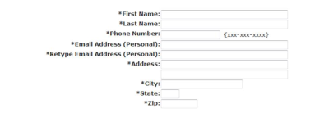
Website visualization(registration)

Slide 12
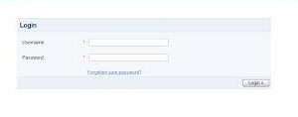
Login page

Slide 13
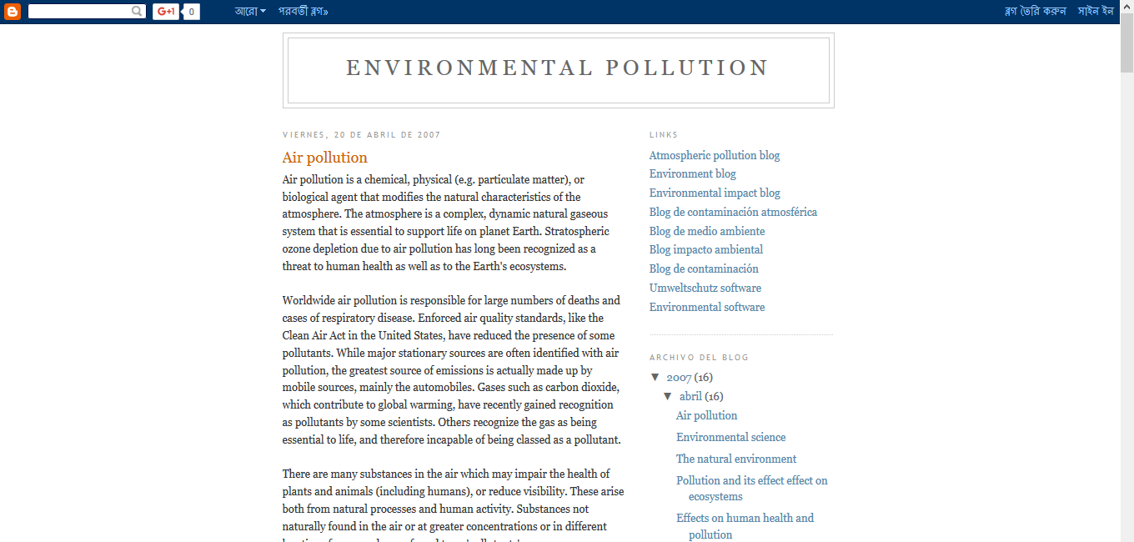
Home page

Slide 14
THANK YOU

